Slide 1
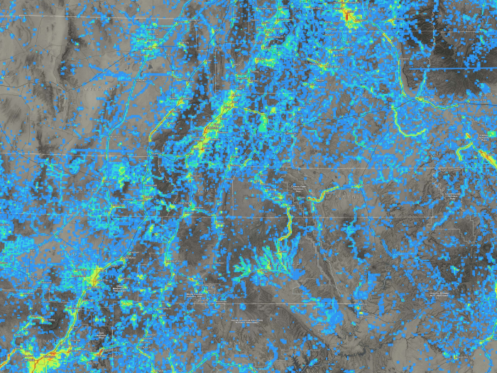


AGRC’s Discover Server
Not Just Google Imagery
Rick Kelson - Utah AGRC
rkelson@utah.gov

Slide 2
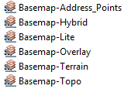
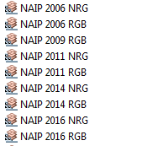

Currently 26 Discover Layers

Slide 3
Utah vs. Google Layer
Utah - scale dependant rendering of the most recent NAIP and Google imagery
Displays NAIP until you zoom in past approx. 1:6,500 and then switches to Google
Google - just the most recent 6” Google imagery

Slide 4
Hybrid Basemap
Basemap - Hybrid - composite of Utah and Basemap - Overlay

Slide 5

Discover is not just a Base Map and Imagery Server
Provides endless valuable usage metrics !
How much does it get used
How long are user requests to the server taking (in real-time)
How much data is being transferred
What layers are being used Or not being used
Where are they being used
Who are the top users

Slide 6
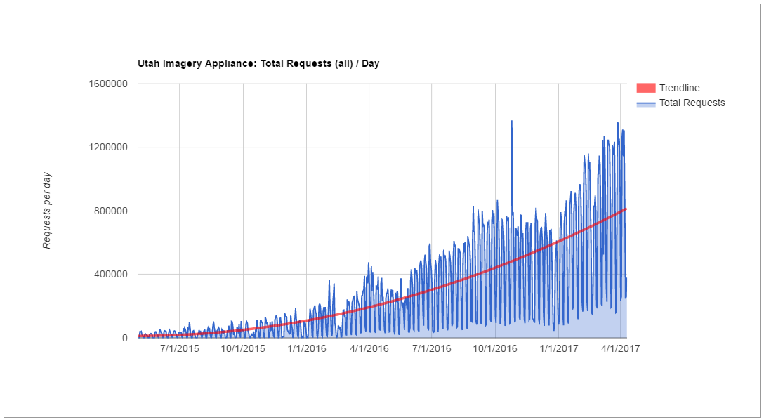
Total Requests to the Server / Day
UGIC 2016

Slide 7
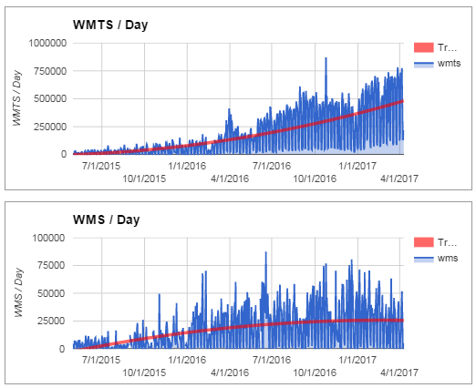
WMTS & WMS Requests

Slide 8
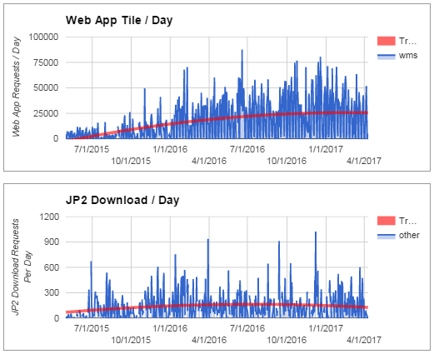
Web Browser Usage and Downloads

Slide 9
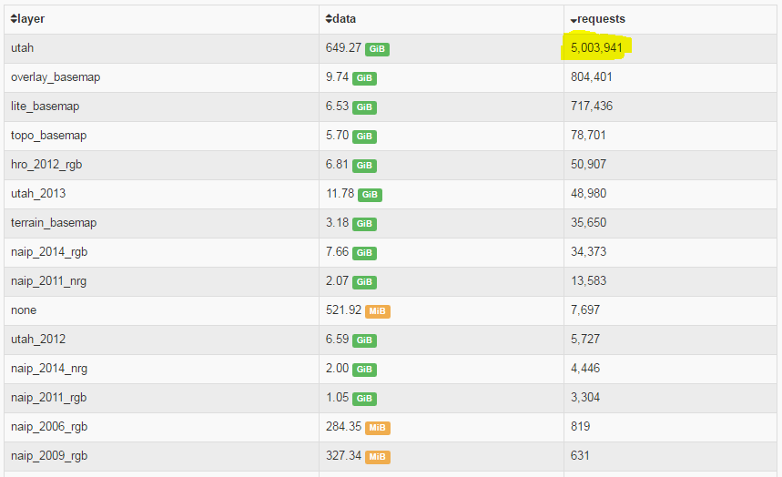
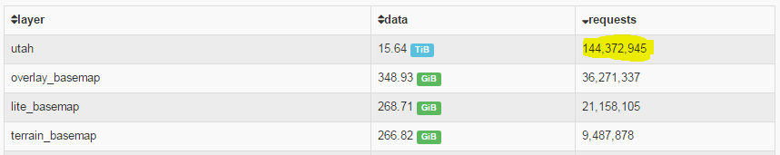
250 Million Total Requests To Date
19 Total Terabytes of Data Transferred To Date
From the beginning of time to April 2016 Usage by Layer
From the beginning of time to April 2017 Usage by Layer

Slide 10
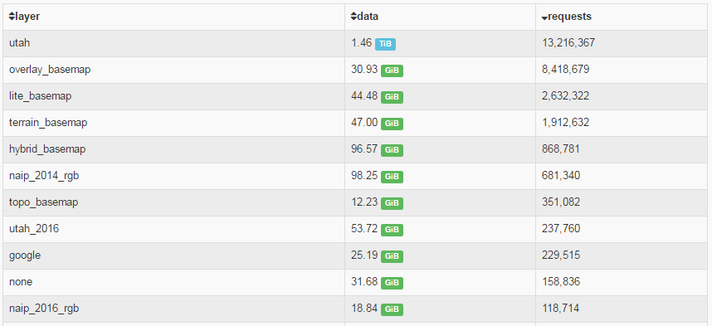
April 2017 Usage
~ 28 Million Total Requests
~2 Total Terabytes of Data Transferred

Slide 11
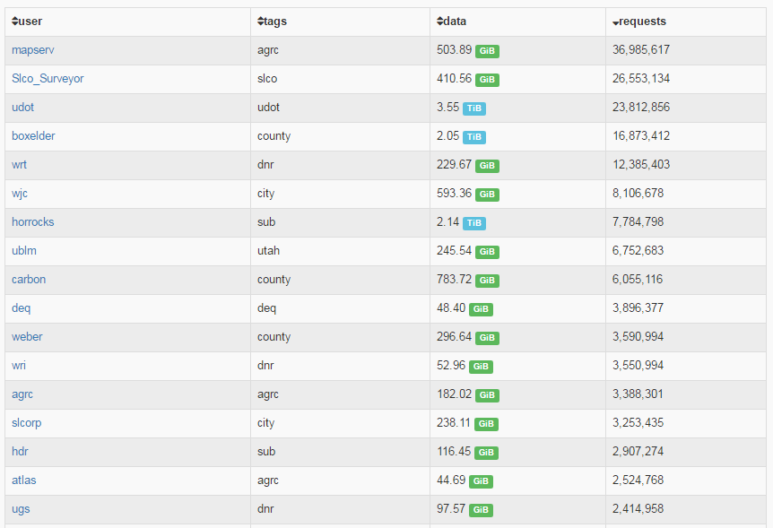
Top Users by # of Requests
AGRC Apps. -
Error -
UDOT -
County -
State -
City -
Subcontractor -
State -
County -
State -
County -
AGRC App. -
State -
City -
Subcontractor -
AGRC App. -
State -

Slide 12
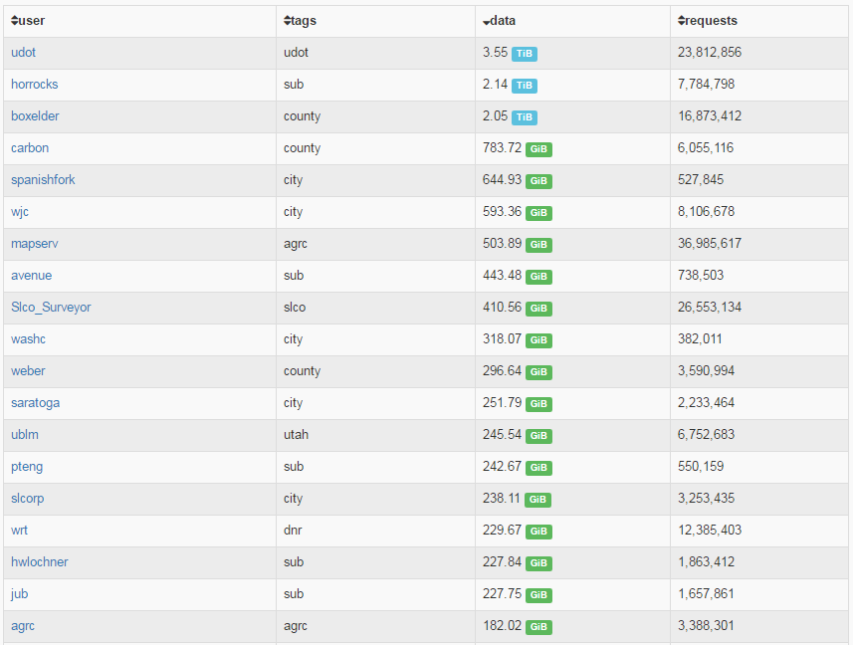
Top Users by Data Transferred
UDOT -
Subcontractor -
County -
County -
City -
City -
AGRC App -
Subcontractor -
County -
City -
County -
City -
City -
State -
Subcontractor -
City -
State -
Subcontractor -
Subcontractor -
State -

Slide 13
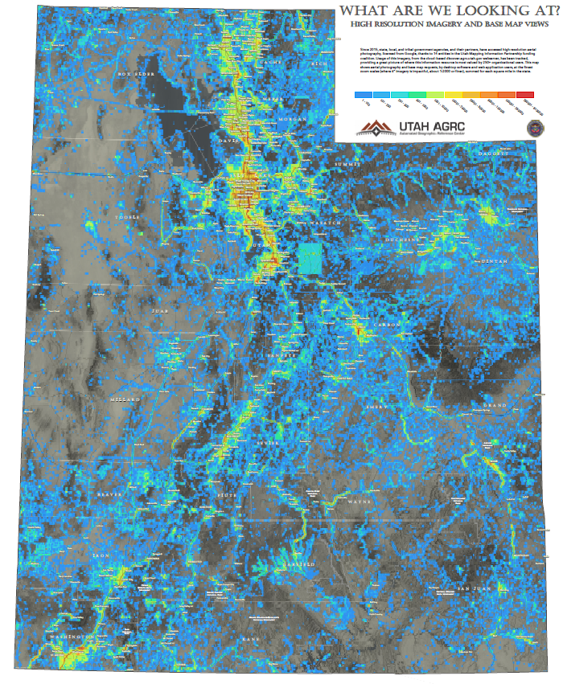
Where are the services being used?
(as you might expect)
Municipalities
Transportation Corridors
New Development
Geologic Features (landslides, faults, etc.)
Oil and Gas Fields
Hydrology & Wetlands
( heatmap data at level 15 (1 km² tiles) of all requests to Discover for levels 18, 19 and 20 )

Slide 14
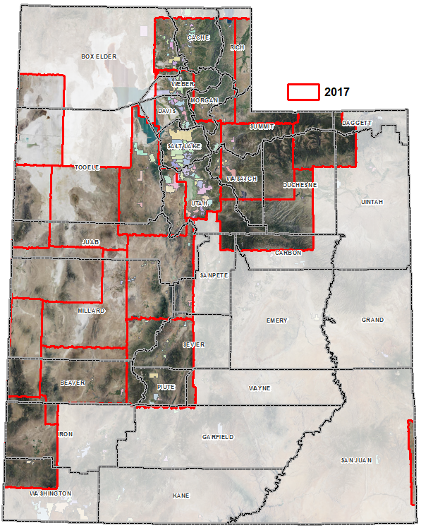
Who wants new imagery this year?
Google Re-Fly Prediction
Still working on the details
~ 95,776 km² to be flown in 2017
$3 per km²

Slide 15
Feedback & Questions?
Rick Kelson
Utah AGRC
rkelson@utah.gov
gis.utah.gov/discover

